Slide 1
Introduction to HCI
What is human-computer interaction (HCI)?
* HCI is the study and the practice of usability.
It is about understanding and creating software and other technology that people will want to use, will be able to use, and will find effective when used.
* HCI is the study of how people use computer systems to perform
certain tasks.
HCI tries to provide us with all understanding of the computer and the person using it, so as to make the interaction between them more effective and more enjoyable.
Introduction to HCI

Slide 2
What is human-computer interaction (HCI)?
* HCI concerns:
process: design, evaluation and implementation
on: interactive computing systems for human use
plus: the study of major phenomena surrounding them
Introduction to HCI

Slide 3
The goals of HCI
Ensuring usability.
“A usable software system is one that supports the effective and efficient completion of tasks in a given work context” (Karat and Dayton 1995).
The bottom-line benefits of more usable software system to business users include:
Increased productivity
Decreased user training time and cost
Decreased user errors
Increased accuracy of data input and data interpretation
Decreased need for ongoing technical support
Introduction to HCI

Slide 4
The goals of HCI
The bottom-line benefits of usability to development organizations include:
Greater profits due to more competitive products/services
Decreased overall development and maintenance costs
Decreased customer support costs
More follow-on business due to satisfied customers
Not to use the term ‘user-friendly’ which intended to mean a system with high usability but always misinterpreted to mean tidying up the screen displays to make it more pleasing
Introduction to HCI

Slide 5
The goals of HCI
To achieve usability, the design of the user interface to any interactive product, needs to take into account and be tailored around a number of factors, including:
Cognitive, perceptual, and motor capabilities and constraints of people in general
Special and unique characteristics of the intended user population in particular
Unique characteristics of the users’ physical and social work environment
Unique characteristics and requirements of the users’ tasks, which are being supported by the software
Unique capabilities and constraints of the chosen software and/or hardware and platform for the product
Introduction to HCI

Slide 6
Humans, Computer and Interaction
The H | Humans good at: Sensing low level stimuli, pattern recognition,inductive reasoning, multiple strategies, adapting “Hard and fuzzy things”.
The C | Computers good at: Counting and measuring, accurate storage and recall, rapid and consistent responses, data processing/calculation, repetitive actions, performance over time, “Simple and sharply defined things”.
The I | The list of skills is somewhat complementary. Let humans do what humans do best and computers do what computers do best.
Introduction to HCI

Slide 7
Different design Needs
Three broad categories of computer user:
Expert users with detailed knowledge of that particular system.
Occasional users who know well how to perform the tasks they need to perform frequently.
Novices who have never used the system before.
Users may well be novices at one computer application but experts at another one, so users will belong to different categories for particular computer systems.
Introduction to HCI

Slide 8
Different design Needs
Strive to understand the important factors, development of tools and techniques, achieve effective and safe system.
Introduction to HCI

Slide 9
Teaching User Interface Development to Software Engineers , Gary Perlman, Ohio University.
“There are not many specialists in user interface development, so most software user interfaces are designed and built by software engineers. These engineers need training about how to build usable and useful user interfaces, but the scarcity of user interface specialists is correlated with the lack of educators ready to train user interface developers.
A software engineer who has been trained in user interface development should have gained perspective, learned about methods and tools, and gained an appreciation of their limits.
Their perspective should include: the importance of the user interface, the impact of good and bad user interfaces, and the diversity of users and applications”.
Introduction to HCI

Slide 10
Teaching User Interface Development to Software Engineers , Gary Perlman, Ohio University.
“About methods and tools they should know: the tradeoffs of design decisions involving different dialogue types and input/output devices, the information resources available for design, the benefits and costs of developing tools for user interface implementation, the need to integrate training materials with the user interface, the need to evaluate system usability, and information about some design and evaluation tools.
Finally, software engineers building user interfaces must know the limits of their knowledge: when and how to work with human factors engineers as consultants for design and evaluation, when and how to work with technical writers for implementation of a system of user guidance, when and how to work with a statistical consultant, and the difficulty of measurement and the complexity of making decisions based on data.”
Introduction to HCI

Slide 11
Visibility and Affordance
Visibility – what is seen
Affordance – what operations and manipulation can be done to a
particular object
What is visible must have a good mapping to their effect
Perceived affordance – what a person thinks can be done to the
object
Introduction to HCI

Slide 12
Importance of HCI
Introduction
In the past, problems with poor interface design of computer software have contributed to an enormous loss in productivity, ranging from increases in time taken to input and process information after computerisation, to deaths from airline crashes due to pilots misreading the instrument readings on their aircraft.
A US study in the 1980s found that:
only 20% of new systems studied were considered to be successes
40 % produced only marginal gains
40 % resulted in rejection or failure of the system
this represents a huge loss of money, time and effort from all of the people involved.
Introduction to HCI

Slide 13
Importance of HCI
HCI will be increasingly important in the following areas:
As part of software development process and system design methods
As part of future legal requirements for software
As the basis for a set of usability criteria to evaluate and choose from
amongst competing products
As the basis for successful marketing strategy to the increasingly
important home and small business user
Introduction to HCI

Slide 14
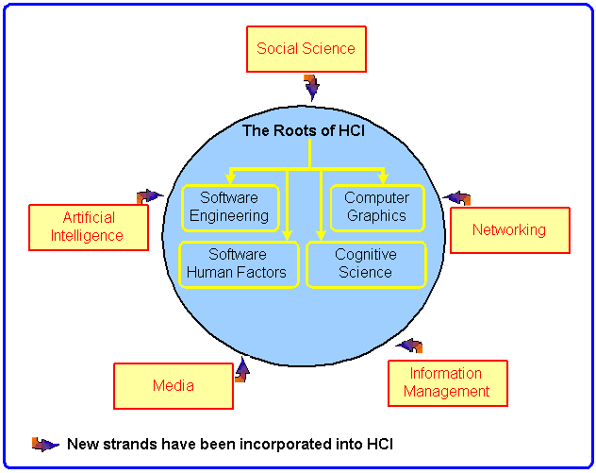
Relationship of HCI to other disciplines
Introduction to HCI

Slide 15
HCI is a multidisciplinary field – HCI draws expertise from a number of different areas of study.
1. Prototyping and and iterative development from software engineering
Design is seen as opportunistic, concrete, and necessarily iterative. By providing techniques to quickly construct, evaluate, and change partial solutions, prototyping has become a fulcrum for system development.
Introduction to HCI

Slide 16
2. Software psychology and human factors of computing systems
This work addressed a wide assortment of questions about people experienced and how they perform when they interact with computers. It studied how system response time affects productivity, how people specify and refine queries, etc.
3. User interface software from computer graphics
Before the 1960s, the focus of computing was literally on computations, not on intelligibly presenting the results.
4. Models, theories and frameworks from cognitive science
These include the disciplined of linguistics, anthropology, philosophy, psychology, and computer science.
Introduction to HCI

Slide 17
This guidance would come from general principles of perception and motor activity, problem-solving and language, communication and group behaviour etc..
It would also include developing theories of HCI. e.g. GOMS rules model for analysing routine human-computer interaction.
Introduction to HCI

Slide 18
A student of HCI will not need to know all these other subjects in depth, of course. However, it is important to be aware that in HCI, we may have to use the
knowledge from some of these disciplines to solve a problem in a certain
situation.
Linguistics
Philosophy
Sociology
Anthropology
Design
Engineering
Ergonomics and human factors
Social and organizational psychology
Cognitive psychology
Artificial intelligence
Introduction to HCI

Slide 19
HCI in the 1990s: HCI research had become relatively well integrated in computer science.
University curricula | HCI was included as one of ten major sections of the first handbook of Computer Science and Engineering. (Tucker 1997).
Computing Industry | HCI practitioners have become well integrated in systems development. HCI specialists have moved into a great variety of roles beyond human factors assurance.
Introduction to HCI

Slide 20
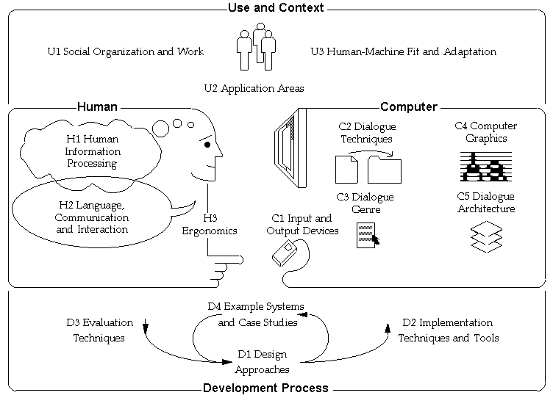
Topics in HCI
Introduction to HCI

Slide 21
Topics in HCI
Computer systems exist within a larger social, organizational and work milieu (U1).
Within this context there are applications for which we wish to employ computer systems (U2).
But the process of putting computers to work means that the human, technical, and work aspects of the application situation must be brought into fit with each other through human learning, system tailorability, or other strategies (U3).
Back
Introduction to HCI

Slide 22
Topics in HCI
In addition to the use and social context of computers, on the human side we must also take into account:
the human information processing (H1)
communication (H2)
and physical (H3) characteristics of users
Back
Introduction to HCI

Slide 23
Topics in HCI
On the computer side, a variety of technologies have been developed for supporting interaction with humans:
Input and output devices connect the human and the machine (C1).
These are used in a number of techniques for organizing a dialogue (C2).
These techniques are used in turn to implement larger design elements, such as the metaphor of the interface (C3).
Getting deeper into the machine substrata supporting the dialogue, the dialogue may make extensive use of computer graphics techniques (C4).
Complex dialogues lead into considerations of the systems architecture necessary to support such features as interconnectable application programs, windowing, real-time response, network communications, multi-user and cooperative interfaces, and multi-tasking of dialogue objects (C5).
Back
Introduction to HCI

Slide 24
Topics in HCI
Finally, there is the process of development which incorporates design (D1) for human-computer dialogues, techniques and tools (D2) for implementing them (D2), techniques for evaluating (D3) them, and a number of classic designs for study (D4).
Introduction to HCI

Slide 25
Earliest and Most influencial HCI research
HCI evoked many difficult problems and elegant solutions in the recent history of computing: direct manipulation, the mouse pointing device, and windows; application areas, such as drawing, text editing and spreadsheets, hypertext, user interface management systems, toolkits, interface builders
“A Brief History of Human-Computer Interaction by Brad A. Myers”
“New Directions in HCI Education, Research and Practice”
http://www.victoriapoint.com/hci_history.html
http://www.sei.cmu.edu/community/hci/directions/
Forces shaping future of HCI
Introduction to HCI

Slide 26
Earliest and Most influencial HCI research
Describe:
the important research development in HCI technology
the forces shaping future of HCI research
Introduction to HCI

Slide 27
The following topics of HCI will be covered through assignments and group presentations/discussion:
Human Characteristics/The human aspects of computing
It is important to understand something about human information-processing characteristics, how human action is structured, the nature of human communication, and human physical and physiological requirements.
Human Information processing
visual perception and graphical representation at the interface
attention and memory constraints
reading, hearing, and others(e.g. movement, touch)
problem solving
learning, errors, skill acquisition
users’ conceptual models, mental models, interface metaphors
Language, Communication and Interaction
Erogonomics
Introduction to HCI

Slide 28
The Technology: Input and Output devices
After studying this topic you should be able to know about a range of different devices and how they can be selected to meet the needs of users, their work and work environments.
Dialogue Inputs
Types of input purposes(e.g. selection, continuous control..)
Input techniques
The hand to input data
Other means of input data (eye movement, the foot, the head, facial
expression, speech and sound
Input for the disabled
Dialogue Outputs
Types of output purposes (e.g. summary information, illustrate processes, create
visualizations of information….)
Output techniques (e.g. scrolling display, windows, animation, fish-eye displays,
sprites..)
Screen layout issues (e.g. focus, clutter, visual logic)
Introduction to HCI

Slide 29
Give examples/illustrate through pictures, where necessary , when describing the issues/concepts.
References: Jenny Preece, Alan Dix, and HCI web resources.
Introduction to HCI

